Slide 1
AGRICULTURAL
PRICE STATISTICS

Slide 2
QUESTIONNAIRE FORMS OF THE PRICES RECEIVED BY FARMERS
AND
LIST OF PRODUCTS BY GROUPS

Slide 3
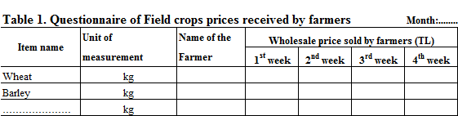

Slide 6
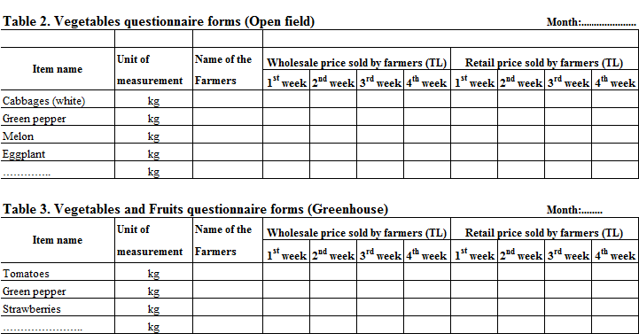

Slide 9
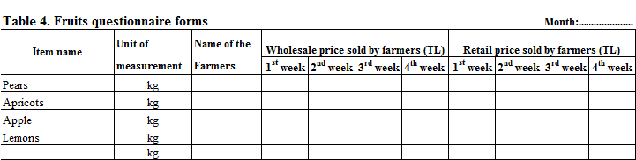

Slide 12
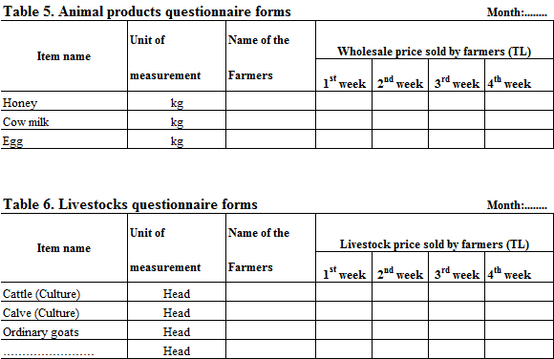

Slide 15
An example of calculating weighted price for items for Turkey

Slide 17
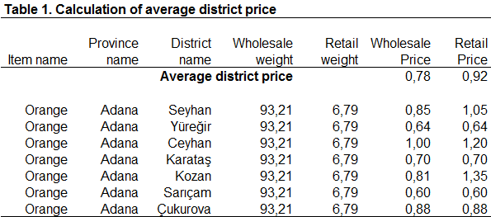

Slide 18
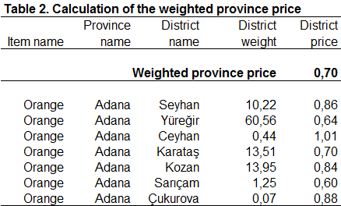

Slide 19
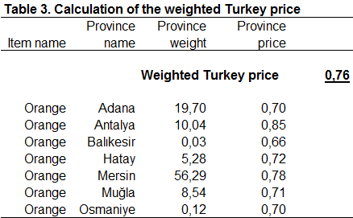

Slide 20
THANK YOU
FOR YOUR ATTENTION!..

